Slide 1


AI FACE DETECTOR WITH PYTHON
S.ESTHER JEBA THANGAM
PRESENTERS

Slide 2

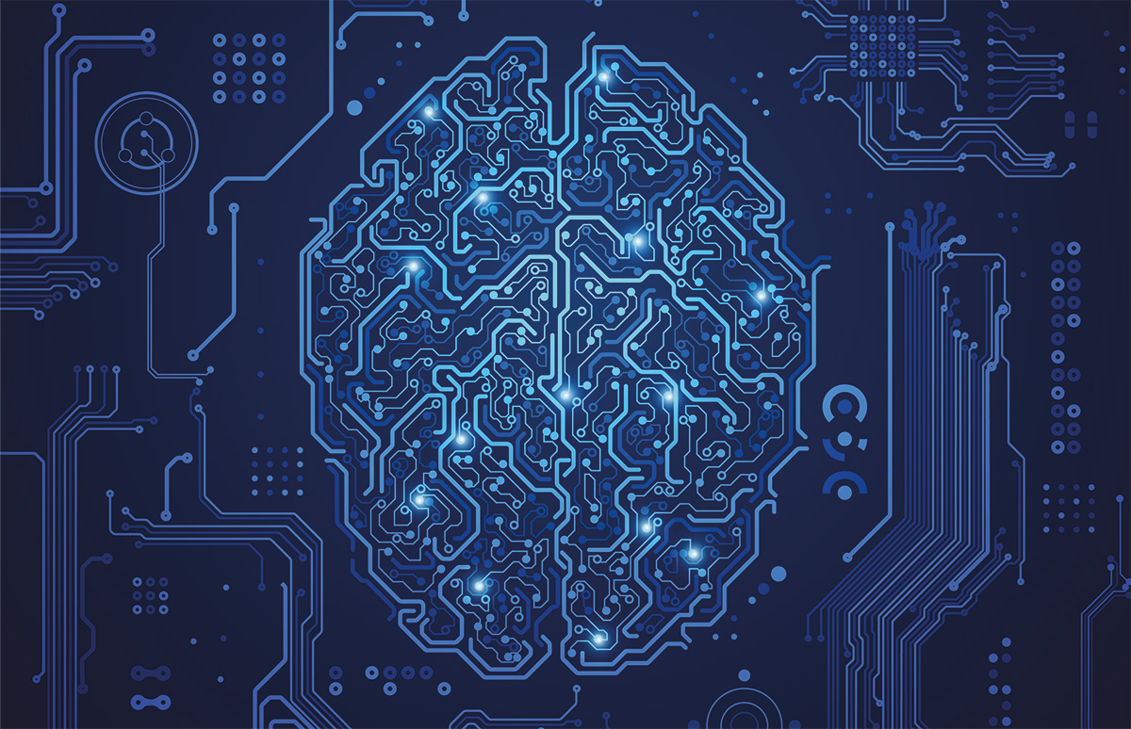
CONTENTS
AI Face Dectector with Python - What I Built ?
AI Face Dectector with Python – Why?
Git usage
Git Hub usage
Git Commands & Workflow
Key Commands & Workflow
Collaboration Value
Project URL
Steps for AI Face Dectector

Slide 3

ARTIFICIAL INTELLIGENCE
Where Machines are Smarter

Slide 4
What I Built?
A Python-based AI system that detects human faces in images and real-time video.
Used OpenCV & Deep Learning models (Haar Cascades / CNN / DNN).
Capable of identifying multiple faces at once.
Can be extended for applications like attendance systems, security, or emotion detection.

Slide 5
Why I Built?
To understand real-world AI applications in Computer Vision.
Face detection is a fundamental step in advanced AI tasks (Face Recognition, Emotion AI, Biometrics).
Industry relevance: used in security, smartphones, healthcare, retail analytics.
Strengthened my knowledge of image processing, ML/DL models, and Python programming.

Slide 6
AI Face Detector
To face the face of human

Slide 7
Git Usage in AI Face Dectector?
Git (Local Version Control):
Tracked code changes while developing face detector.
Created Commits for major features
Data Processing
Model Training
Face Detection Pipeline
Used branches to test improvements (e.g., CNN vs Haar Cascade).
Enabled easy rollback if errors occurred.

Slide 8
Git Hub Usage in AI Face Dectector?
GitHub (Remote Repository):
Hosted project repo for backup and sharing.
Used README.md to explain project details & usage.
Managed issues and future improvements.
Allowed collaboration (team members could clone, contribute & review).
Provided a professional portfolio link (GitHub repo) for showcasing work

Slide 9
Git Commands & Workflow – in AI Face Dectector?
📌 Initialization
git init
Create a new local repository for the project.
🌿Branching & Merging
git checkout -b feature-branch
git merge feature-branch
Work on new features (e.g., CNN integration) safely.
Merge into main branch after testing
📊 Status Log
git status
git log --oneline

Slide 10
Git Commands & Workflow – in AI Face Dectector?
📊 Status Log
Track uncommitted changes.
View concise commit history (e.g., “Added Haar Cascade detection”, “Integrated CNN”).
git clone <repo url> (from GitHub)
git add .->git commit –m “message”
git push origin main

Slide 11
Key Commands & Workflow– in AI Face Dectector? Challenges faced
Accidentally Committing Large/Unwanted Files
Problem: Pushed unnecessary files (e.g., dataset,
cache).
Solution: Used .gitignore to exclude them from tracking
Merge Conflicts During Branching
Problem: Conflicts when merging feature branches.
Solution: Resolved by reviewing changes, fixing differences, and committing the corrected version.

Slide 12
Key Commands & Workflow– in AI Face Dectector? Learnings
📜 Git History & Recovery
Learned how Git maintains history, making it easy to revert mistakes and track progress.
🌿 Branching for Experiments
Understood how branching enables safe experimentation without breaking the main code.
Collaboration with GitHub
Experienced how pull requests & issue tracking streamline teamwork and code reviews.

Slide 13
Key Commands & Workflow– in AI Face Dectector? Challenges faced
Commit Practices
Problem: Initially made large or unclear commits.
Solution: Learned to keep commits small, meaningful, and descriptive.

Slide 14
Collaboration Value – Why Git/GitHub Matter in Teams
🗂 Version Control
Everyone works on the latest code without overwriting others’ changes.
🌿 Branching & Merging
Enables multiple features (e.g., CNN, Haar Cascade, DNN integration) to be developed in parallel.
👀 Transparency
Team members can track progress, review code, and give feedback easily.

Slide 15
Collaboration Value – Why Git/GitHub Matter in Teams
☁️ Backup & Remote Access
Code is always safe, secure, and accessible on GitHub.
🛠 Collaboration Tools
Issues, Pull Requests, Discussions improve teamwork and accountability.

Slide 16
AI Face Detector Project URL
https://github.com/ohmsolutionsk-jpg/SmileDetection

Slide 17

PYTHON LIBRARIES
OpenCV or cv2

Slide 18
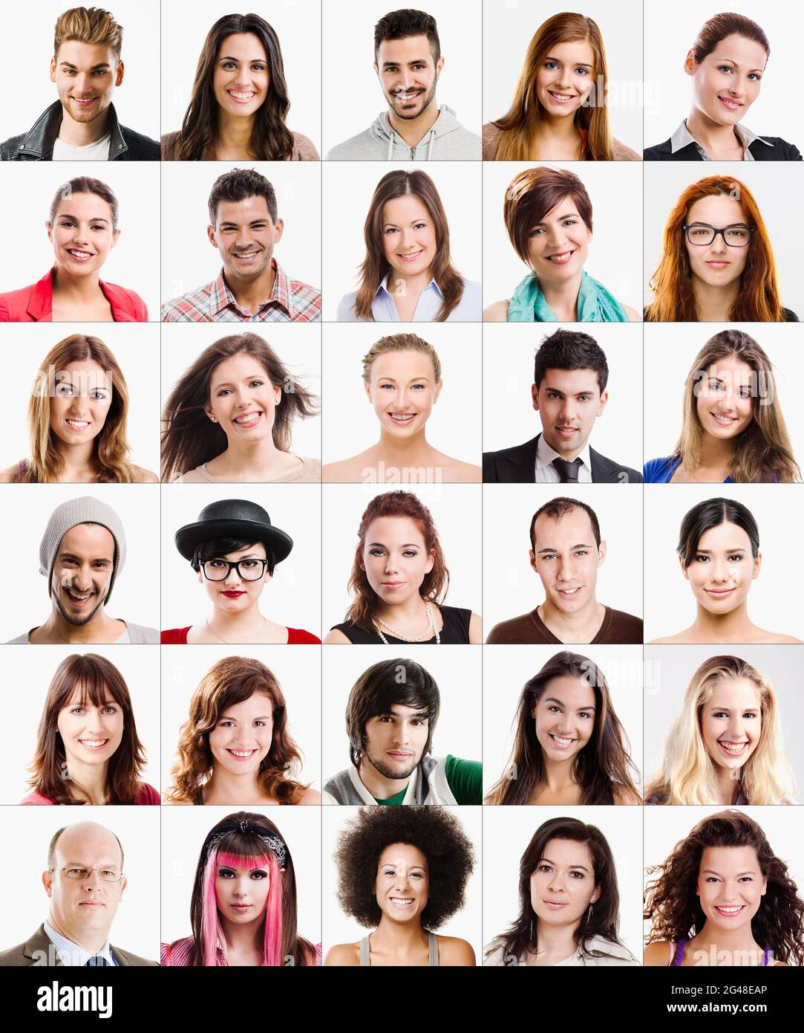
AI Face Detector
Step 1:
Input: Image/Video Stream

Slide 19
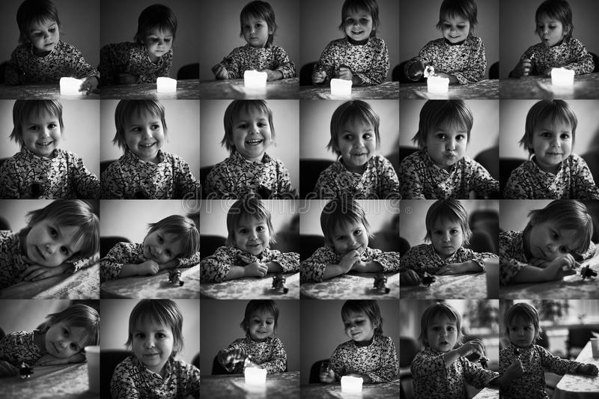
AI Face Detector
Step 2:
Preprocessing: Grayscale,Resize, Noise Reduction

Slide 20
AI Face Detector
Step 3:
Detection: Haar Cascade / HOG / Deep Learning Models

Slide 21
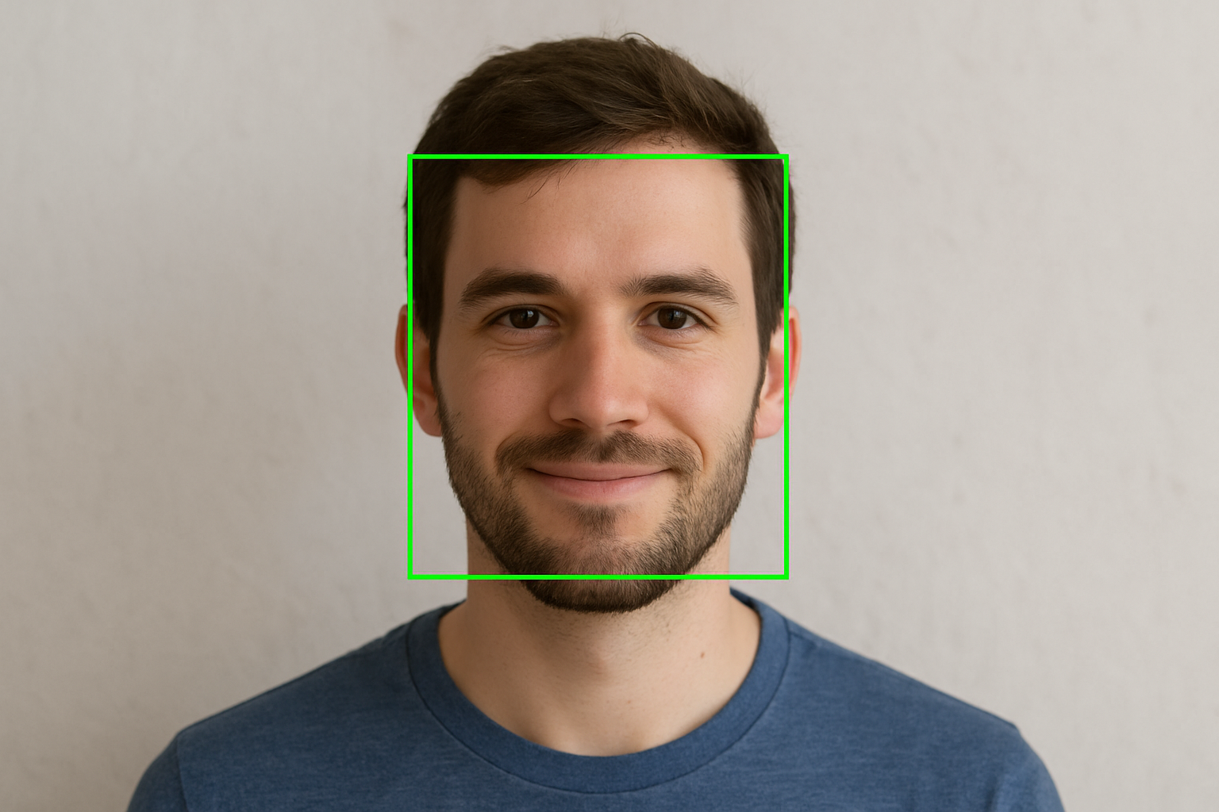
AI Face Detector
Step 4:
. Output: Bounding boxes around faces

Slide 22

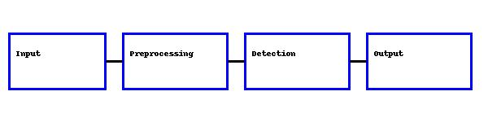
PREDICTING THE FUTURE ISN’T MAGIC, IT’S AI
- Dave Waters

Slide 23
THANK YOU!
ANY QUESTIONS

